Slide 1


Data Visualization: Principles and Applications in R, Tableau, and Python
Silas Bergen
Todd Iverson
2019 Symposium on Statistics and Data Science
Bellevue, WA

Slide 2
SDSS data viz sessions to note
Thursday 10:30-12: Visual Storytelling
Alberto Cairo, U Miami
Matthew Brehmer, Microsoft
Amber Thomas, The Pudding
Thursday 1:30-3: Data viz in Python
Stephen Elson, Quantia Analytics
Dominik Moritz, U Washington
Kanit “Ham” Wongsuphawat, Apple
Friday 1:30-3: Data viz education
Michael Freeman, U Washington
Jerzy Wieczorek, Colby College
Robert Kosara, Tableau
Friday 3:40-5:15: Data viz at the IHME
Ryan Shackleton, IHME
Evan Laurie, IHME
Marlena Bannick, IHME
Friday 5:20-6:25: GoG 20th Anniversary
Lee Wilkinson, H2O.ai
Anushka Anand, Tableau
Jeffrey Heer, U Washington
Bryan Van de Ven, Microsoft
Saturday 10-11:30: GoG From Theory to Applications
Steven Drucker, Microsoft
Claus Wilke, U Texas Austin
Anushka Anand, Tableau
See entire data viz track: https://bit.ly/2QeAWFe

Slide 3
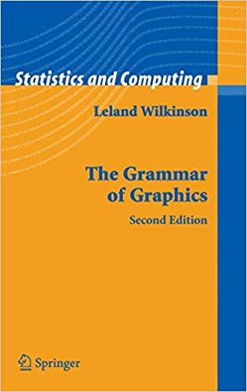
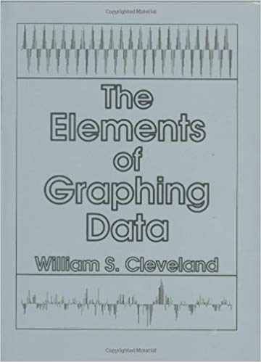

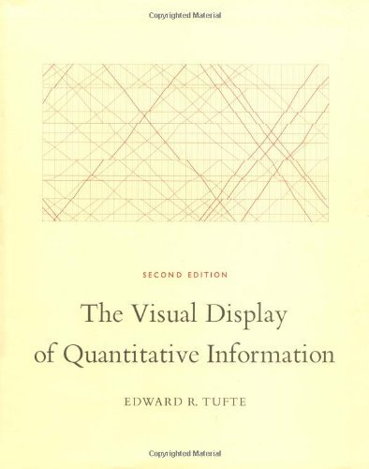
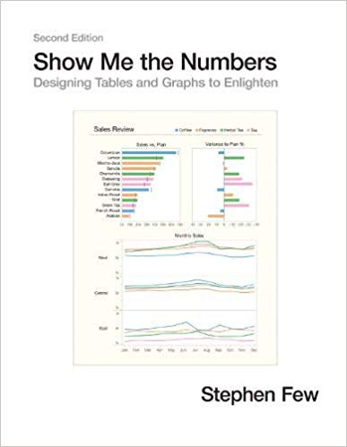
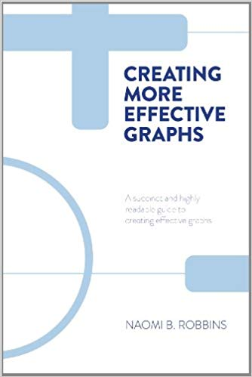


Slide 4
In the visualizations that follow:
What information can you extract?
How are you extracting this information?

Slide 5
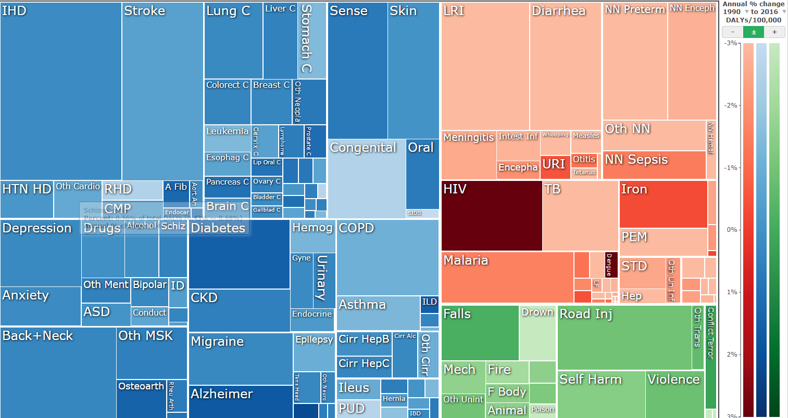
IHME disability adjusted life years (DALYs) visualization
https://vizhub.healthdata.org/gbd-compare/

Slide 6
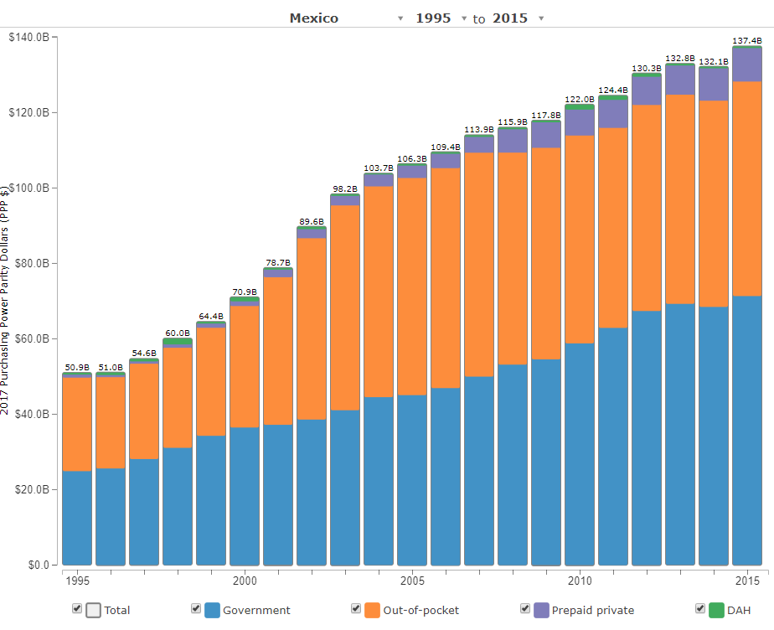
IHME health care spending visualization
(DAH = Development Assistance for Health)
http://ihmeuw.org/4iuu

Slide 7
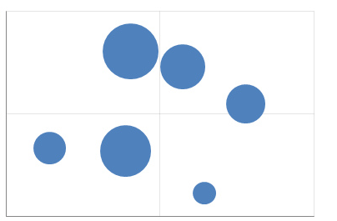
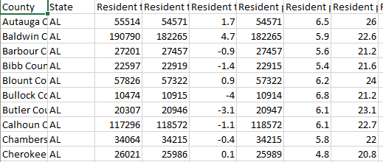
What is a data visualization?
A set of visual geometries whose aesthetics are mapped from data
Many major visualization software (Tableau, ggplot in R, Altair in Python, graph builder in JMP) are based on this grammar
Aesthetics
Data
Geometries

Slide 8
Geometry
A geometry is a visual entity in space.
Some common geometries encountered in data visualizations:
Point
Line
Bar

Slide 9
Aesthetic
An aesthetic is a visual attribute of a geometry
Common aesthetics:
Position on horizontal (X)
Position on vertical (Y)
Shape
Size
Color
Hue
Saturation (“intensity”)
Value (“brightness”)
Text
Not all aesthetics are available for every geometry

Slide 10

HUE
SATURATION
https://color.adobe.com/build2.0.0-buildNo/resource/img/kuler/color_wheel_730.png

Slide 11
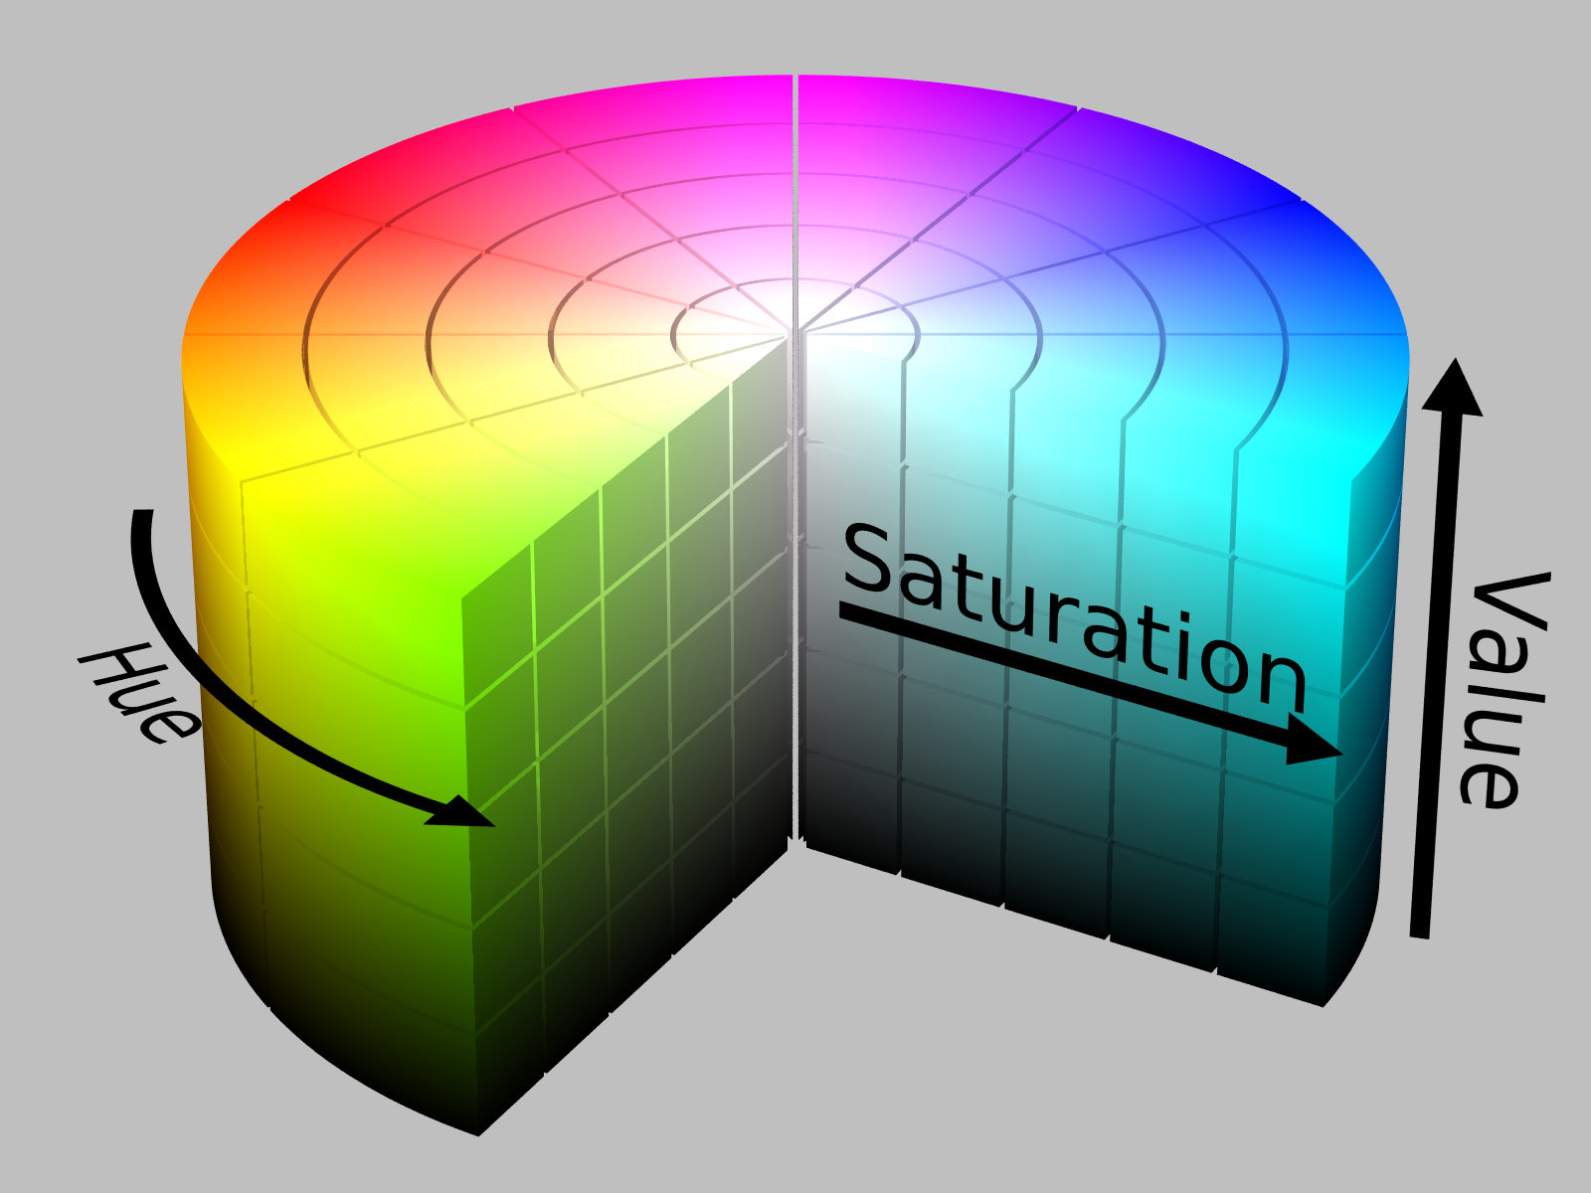
https://upload.wikimedia.org/wikipedia/commons/0/0d/HSV_color_solid_cylinder_alpha_lowgamma.png

Slide 12
Aesthetic attributes of a point geometry
What distinguishes one point from another point?
X, Y
Shape
Size
Hue
Saturation
Value
Text
Point B
Point A

Slide 13
Aesthetic attributes of a line geometry
What distinguishes one line from another line?
X, Y
Shape
Size
Hue
Saturation
Value

Slide 14
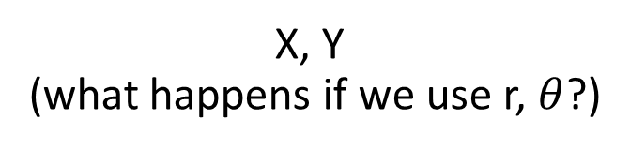
Aesthetic attributes of a bar geometry
What distinguishes one bar from another bar?
X, Y
(what happens if we use r, $θ$?)
Shape
Size
NA
(a bar is a bar!)
Hue
Saturation
Value

Slide 15
Data
To visualize, must have data in row-by-column format where:
Rows represent cases: at most one geometry per case (assuming no aggregation)
Columns represent variables: to be mapped to aesthetic attributes

Slide 16
Specifying a data visualization
Differences in geometry aesthetics map to differences in data variables
Available mappings depend on whether data variable is continuous (height) or discrete (race)

Slide 17


Specifying a data visualization
The following caveats apply:
An aesthetic attribute can be mapped back to at most one variable
A variable can be mapped to more than one aesthetic
Not all mappings make sense
Height
Size
Age
Size
Sex
Hue
Height
Shape

Slide 18
Modifiers
Ties: when two cases yield overlapping geometries under a given mapping
Some common modifiers:
Jitter: Stack: Dodge:
+
=

Slide 19
Specify the mappings!
Revisit the three visualizations we encountered earlier. Identify:
The data cases (assuming one geometry per case);
The geometries;
The aesthetic attributes that are varied;
The variables that control the differences in aesthetic attributes (bonus: are they continuous or discrete?)
Modifiers (if any)

Slide 20
IHME GBD visualization
https://vizhub.healthdata.org/gbd-compare/
Notes:
Quickly; add “key” slides

Slide 21
IHME health care spending visualization
(DAH = Development Assistance for Health)
http://ihmeuw.org/4iuu
Notes:
Quickly; add “key” slides

Slide 22
Visual perception
How we compare quantities

Slide 23
Recall the following aesthetic attributes:
Position on horizontal (X)
Position on vertical (Y)
Shape
Size
Color
Hue
Saturation (“intensity”)
Value (“brightness”)
Cleveland & McGill created a ranking of these when mapping a geometry to a quantitative variable

Slide 24
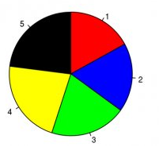
Hypothetical polling data on 5 candidates.
Rank the candidates’ vote shares.
Walter Hickey at Business Insider
Specification
Geometry: “pie wedge” (a bar in polar coordinates)
Aesthetic mappings:
Candidate (discrete) → hue & text
share of vote (continuous) → size, specifically angle

Slide 25
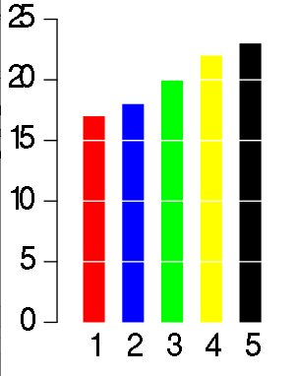
Same data, different visualization
Rank the candidates’ vote shares.
Walter Hickey at Business Insider
Specification
Geometry: bar
Aesthetic mappings:
candidate → hue & X
share of vote → Y

Slide 26
Elementary perceptual tasks
a set of tasks that are carried out when people extract quantitative information from graphs
Cleveland and McGill. Graphical Perception: Theory, Experimentation, and Application to the Development of Graphical Methods. JASA, 1984

Slide 27
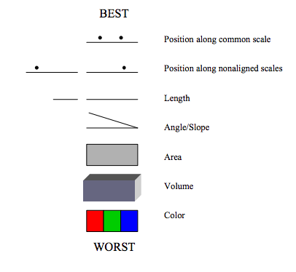
Cleveland’s and McGill’s hierarchy of elementary perceptual tasks
Image source: Wilkinson, Presentation Graphics

Slide 28
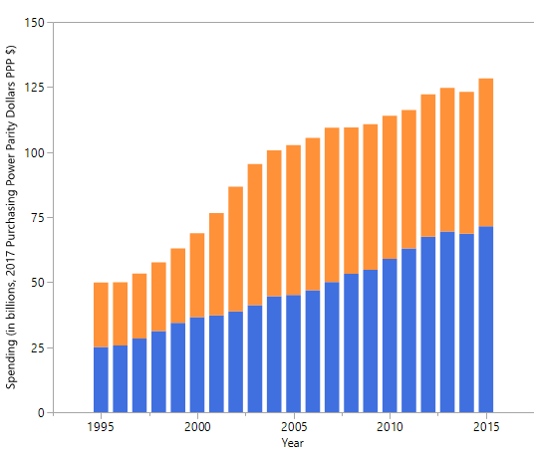
Mexico’s health spending (Government and Out-of-pocket only)
Geometry: Bar
Year → X
Spending → Y
Source → Hue
Modifier: Stack
Geometry: Bar
Year → X
Spending → Y
Source → Hue
Modifier: Dodge
Geometry: Point
Year → X
Spending → Y
Source → Hue, Shape
Modifier: None

Slide 29
Gestalt principles
How we perceive groups

Slide 30
gestalt = form or pattern
Gestalt philosophy: the whole is greater than the sum of the parts
Gestalt principles: predictable ways by which we organize sensory information
Developed by Max Wertheimer & followers; early 20th century

Slide 31
Find the fives
6
3
1
2
1
9
5
3
2
8
5
5
7
5
5
4
9
5
5
4
3
6
5
3
9
4
3
5
8
2
2
1
5
7
4
3
1
5
5
7
6
5
9
8
4
2
4

Slide 32
Find the fives
6
3
1
2
1
9
5
3
2
8
5
5
7
5
5
4
9
5
5
4
3
6
5
3
9
4
3
5
8
2
2
1
5
7
4
3
1
5
5
7
6
5
9
8
4
2
4
Inspired by Fig 6.2, The Functional Art by Alberto Cairo

Slide 33
Similarity
rows or columns?

Slide 34
Similarity
rows or columns?

Slide 35
Proximity
rows or columns?

Slide 36
Connection
rows or columns?

Slide 37
Enclosure
rows or columns?

Slide 38
Some principles are stronger than others

Slide 39
rows or columns?

Slide 40
rows or columns?

Slide 41
What are the groups?
Within group: rows or columns?
Notes:
Left/right
Within left: columns; within right: rows

Slide 42
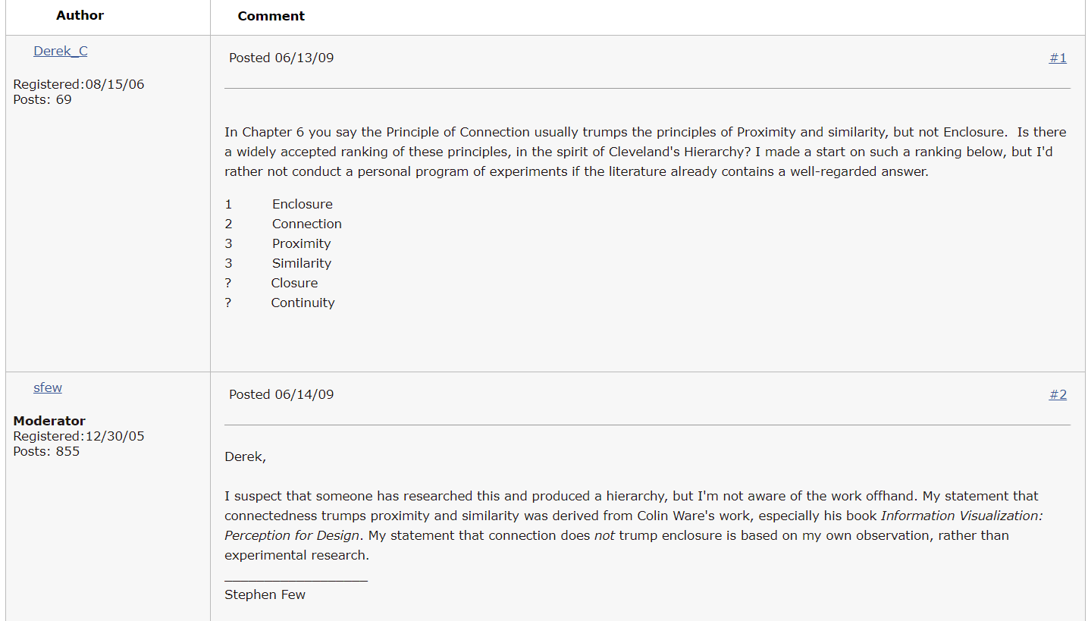
http://sfew.websitetoolbox.com/post/ranking-the-gestalt-principles-3524646 (now unavailable; 5/8/19)

Slide 43
color usually trumps shape when incorporating similarity

Slide 44
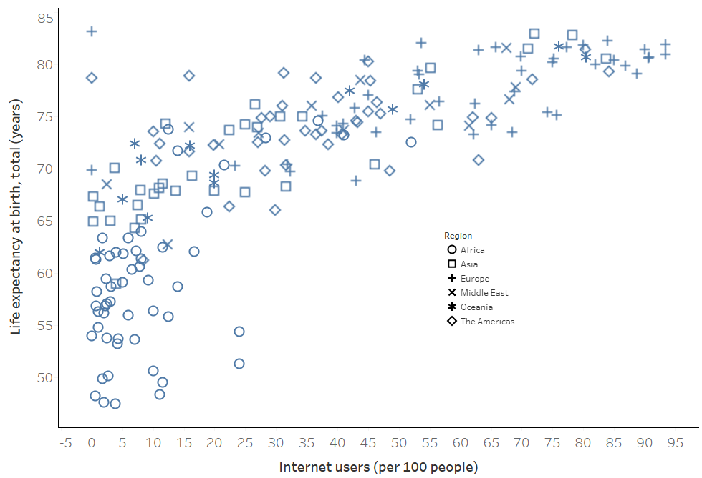
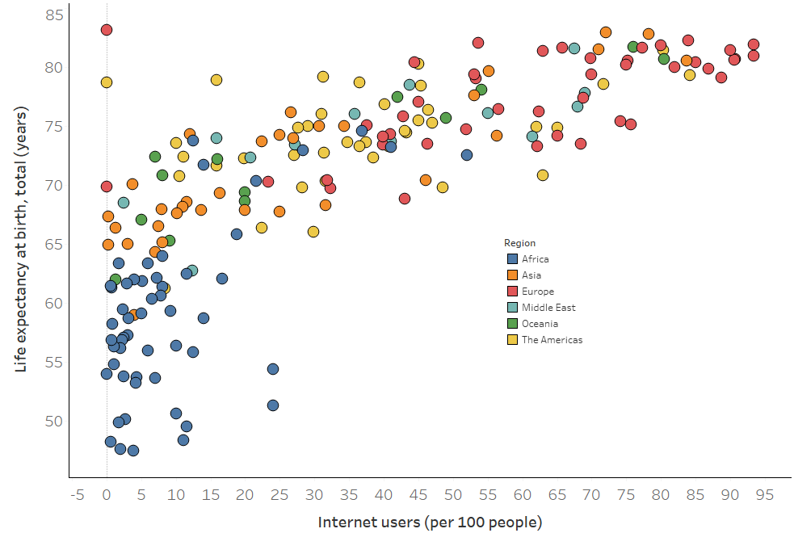
Data source: World Bank, 2010 indicators

Slide 45
but you can double up

Slide 46
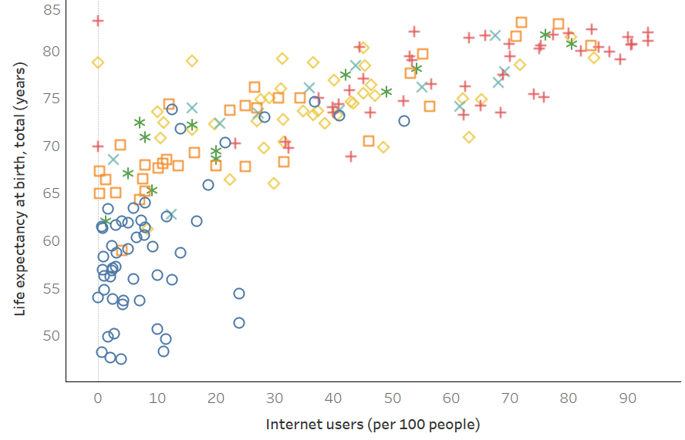

Slide 47
Implications for practice
Know how we compare quantities
Know how we perceive groups
Employ these principles to facilitate the most important comparisons
“The most important comparisons” depend on your message

Slide 48
> fake_data
Factor1 Factor2 Response
1 A I 15
2 A II 5
3 A III 5
4 B I 10
5 B II 15
6 B III 15
7 C I 5
8 C II 10
9 C III 10

Slide 49
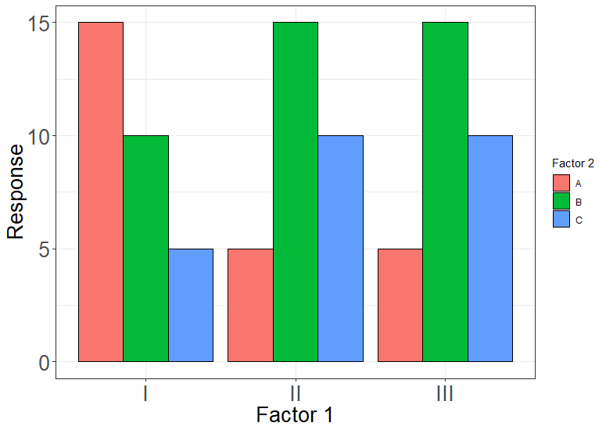
Geom: bar
Position_X: Factor 1
Color: Factor 2
Position_Y: Response
Notes:
775 x 550; proximity

Slide 50
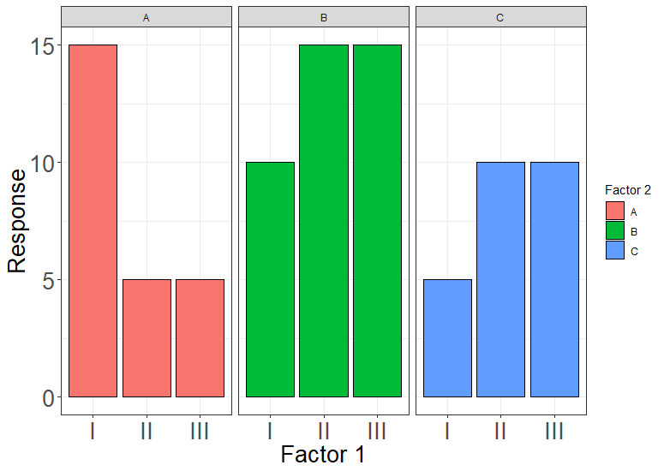
Geom: bar
Position_X: Factor 1
Color: Factor 2
Position_Y: Response
FACET: Factor 2
Notes:
775 x 550; proximity + enclosure

Slide 51
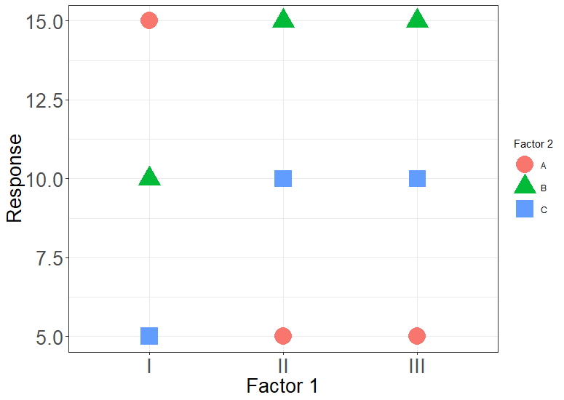
Geom: point
Position_X: Factor 1
Color: Factor 2
Shape: Factor 2
Position_Y: Response
Notes:
What am I supposed to look at? Similarity is too weak

Slide 52
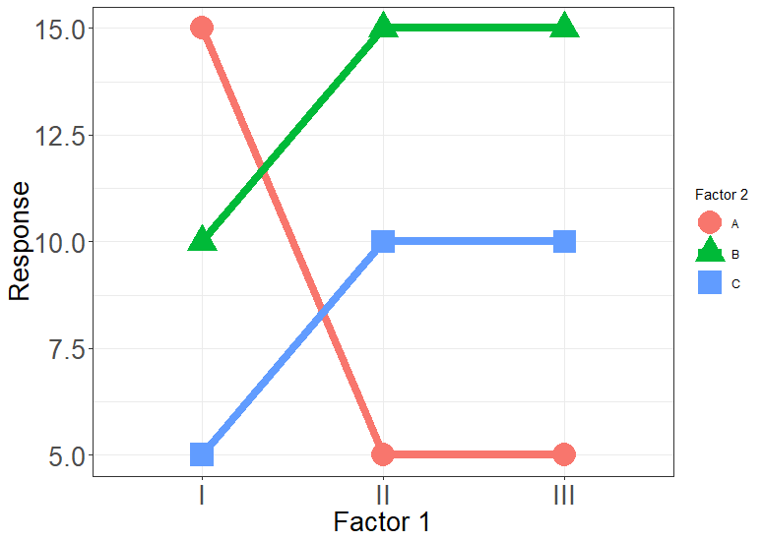
Geom: point
Position_X: Factor 1
Color: Factor 2
Shape: Factor 2
Position_Y: Response
Geom: line
Position_X: Factor 1
Color: Factor 2
Group: Factor 2
Position_Y: Response
Notes:
Adding connection helps

Slide 53
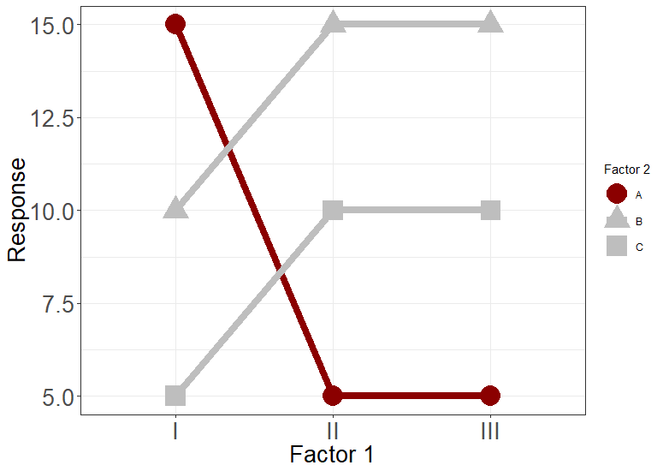
Geom: point
Position_X: Factor 1
Color: Is_neg
Shape: Factor 2
Position_Y: Response
Geom: line
Position_X: Factor 1
Color: Is_neg
Group: Factor 2
Position_Y: Response
Notes:
Similarity + connection

Slide 54
Geom: point
Position_X: Factor 1
Color: Is_neg
Shape: Factor 2
Position_Y: Response
Geom: line
Position_X: Factor 1
Color: Is_neg
Group: Factor 2
Position_Y: Response
Notes:
Enclosure + Similarity + connection

Slide 55
Design

Slide 56

Alberto Cairo
http://www.thefunctionalart.com/

Slide 57
The five qualities of great visualizations
Truthful
Functional
Beautiful
Insightful
Enlightening
Alberto Cairo, The Truthful Art, Ch 2.

Slide 58
1. Truthful
Is the visualization based on thorough and honest research?

Slide 59
2. Functional
Does the visualization facilitate meaningful comparisons?

Slide 60
3. Beautiful
Is it attractive, intriguing, and aesthetically pleasing?

Slide 61
4. Insightful
Does the visualization elicit an “a-ha”, a “wow”, an “I see”?

Slide 62
5. Enlightening
Does the visualization cast light over relevant issues? Will it “change minds”?

Slide 63
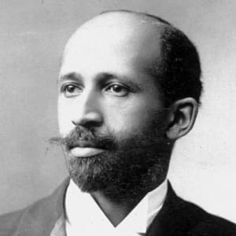
Exposition Universelle Paris World Fair 1900
W.E.B. Du Bois
Sociologist, Atlanta University

Slide 64
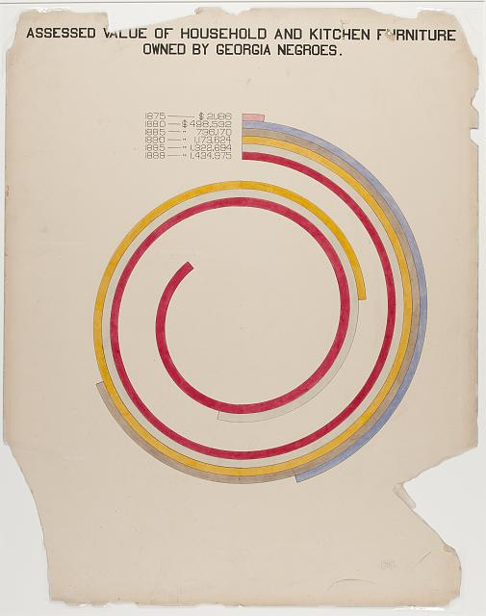
Image Source: https://www.loc.gov/pictures/resource/ppmsca.33887/?co=anedub
Notes:
Beautiful: Pre-empts the Avant Garde European art movement

Slide 65
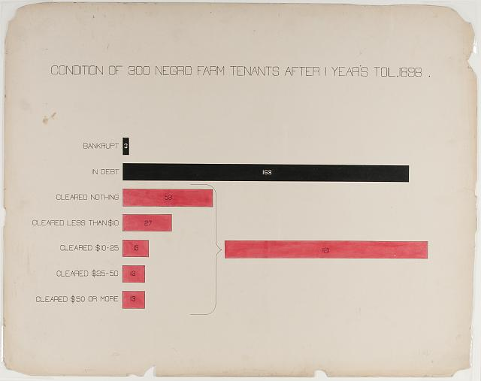
Image Source: https://www.loc.gov/pictures/resource/ppmsca.33892/?co=anedub
Notes:
Insightful: Power of annotation

Slide 66
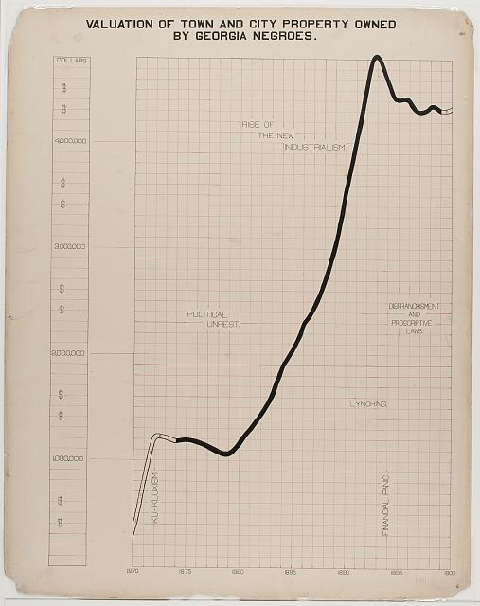
Image Source: https://www.loc.gov/pictures/resource/ppmsca.33883/?co=anedub
Notes:
Insightful: Power of annotation

Slide 67
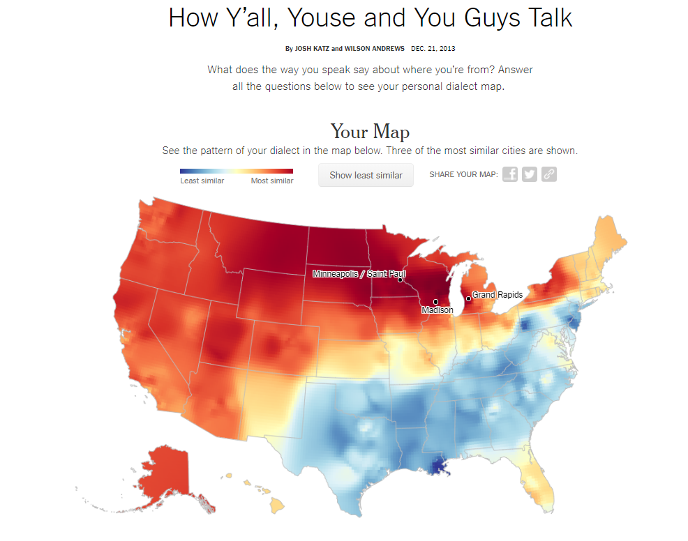
https://www.nytimes.com/interactive/2014/upshot/dialect-quiz-map.html

Slide 68
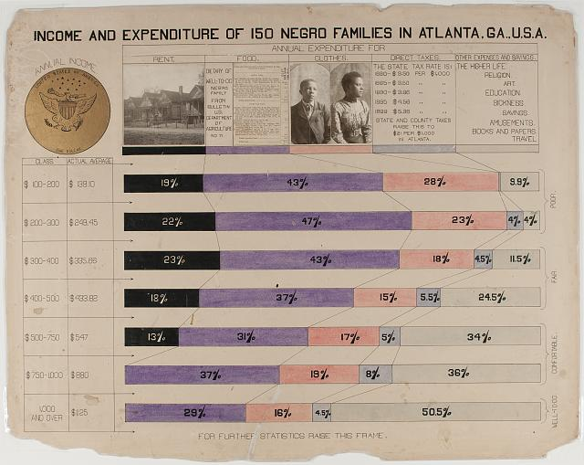
Image Source: https://www.loc.gov/pictures/resource/ppmsca.33893/?co=anedub
Notes:
When a legend is more than just a legend

Slide 69
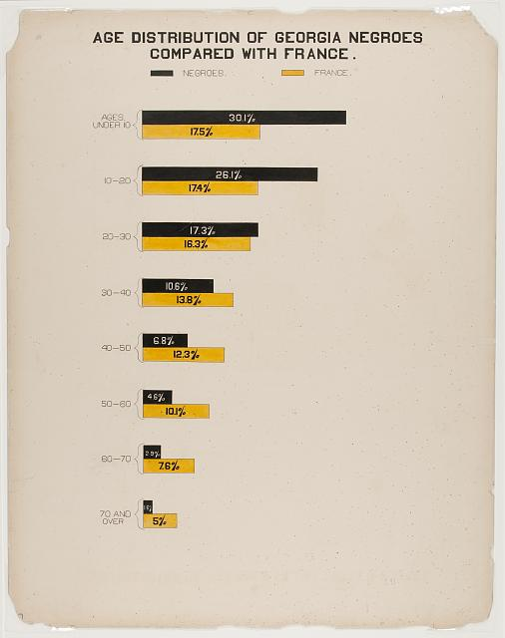
Image Source: https://www.loc.gov/pictures/resource/ppmsca.33871/?co=anedub
Notes:
The “Me” factor

